Slide 1
Spaces

Slide 2
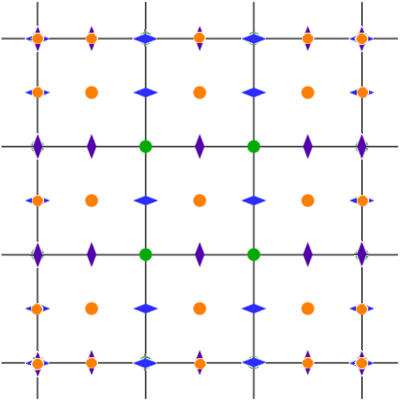
Divergence
Diagram for x calculation

Slide 3
Cell data Gradient
Diagram for x calculation

Slide 4
Face data Gradient
= modified stencil
Padding: tangential terms
= ordinary stencil
Diagram for x calculation

Slide 5
Face data Laplacian
= modified stencil
Padding: tangential terms
= ordinary stencil
Diagram for x calculation

Slide 6
Face Average
Padding: all terms
Cell I,j,k
Diagram for x calculation

Slide 7
Face data Curl
Diagram for x calculation

